Slide 1
SLEEP STOPPERS
Team:
Sumeet DeshPande
Devanshu Dighe
Priyanka Sharma
Akshay orpe

Slide 2
Problem Statement
Increasing number of accidents due to driver fatigue
Build a solution to detect driver fatigue levels
Drowsiness is one of the biggest indicators of driver fatigue

Slide 3
Approaching the problem
Data Collection
Data Pre-processing
Build/Train Model
Test the Model

Slide 4
Model selection
Why Convolutional Neural Networks?
CNN is known to outperform other ML algorithms on conventional image recognition
CNN is more efficient in terms of memory as compared to regular neural networks
It is less complex
CNN has a high accuracy index

Slide 5
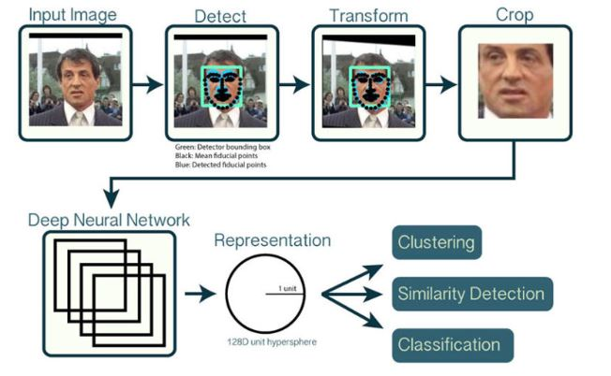

Slide 6

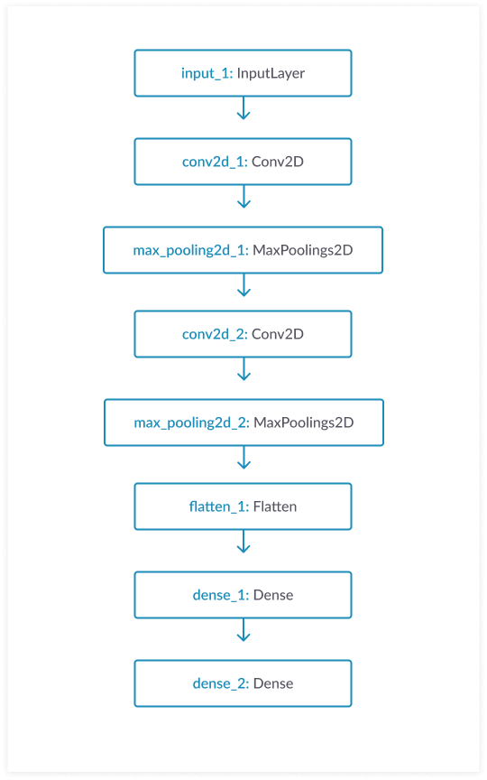
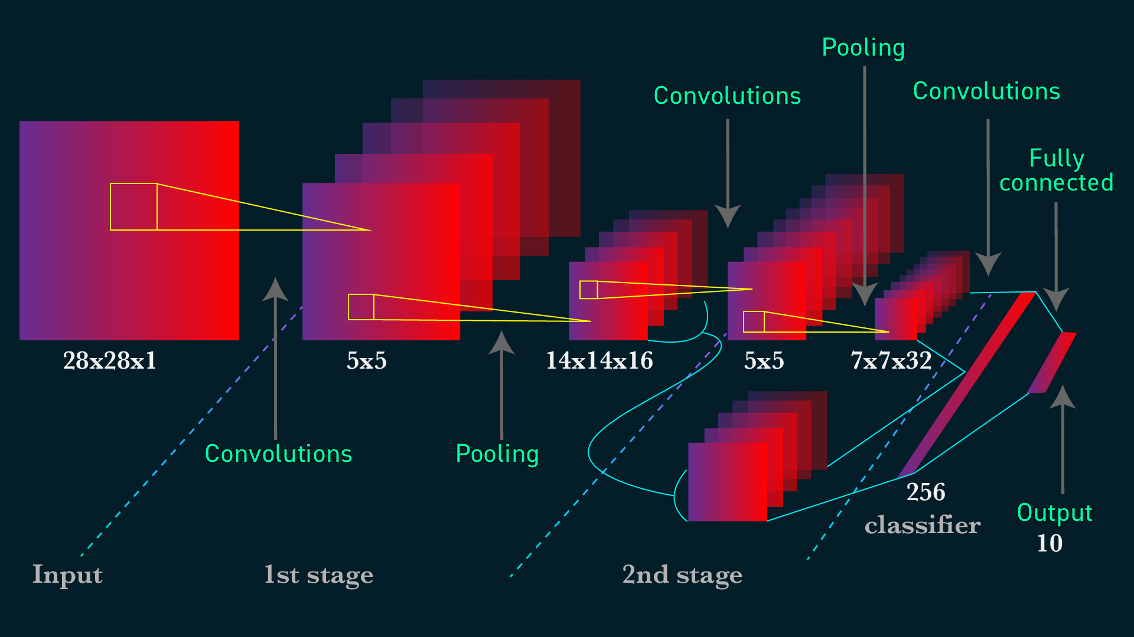
Model Architecture

Slide 7
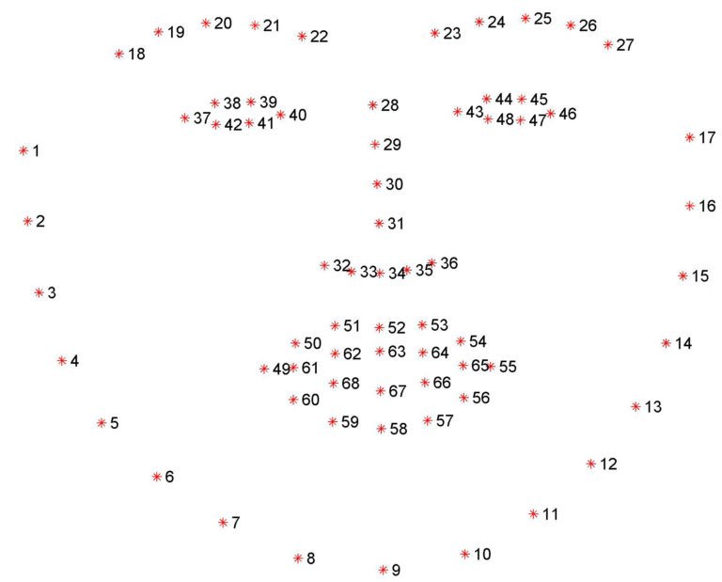

Slide 8
Demonstration

Slide 9
Use cases
Cab Service Providers:
It will help these companies enhance travel security for both drivers and customers
Security Agencies:
As more and more companies deploy CCTV camera’s, the job of the modern guard has largely become monitoring the footage 24x7
This solution can help raise alarms by detecting fatigue levels of an on-duty guard

